Slide 1

Chapter 13
Expressive Culture
Notes:
For a better classroom presentation flow, the order of some topics in this lecture outline differs slightly from the order of topics in the text and, where this occurs, some figures and tables are out of numerical order.

Slide 2
Learning Objectives
13.1 Summarize how culture is expressed through art.
13.2 Illustrate what play and leisure reveal about culture.
13.3 Explain how cultural heritage is a contested resource in contemporary times.

Slide 3
Expressive Culture
Expressive culture
  Behavior and beliefs related to art, leisure, and play

Slide 4
Art and Culture
13.1 Summarize how culture is expressed through art.
What Is Art?
Studying Art in Society
Performance Arts
Architecture and Decorative Arts
Museums and Culture

Slide 5
What Is Art? (1 of 5)
Anthropological definition of art
  The application of imagination, skill, and style to matter, movement, and sound that goes beyond what is purely practical
    A broad definition to encompass the (emic) definitions of art among diverse cultures

Slide 6
What Is Art? (2 of 5)
The traditional Western view distinguishes “fine” art and “folk” art
  “Fine” art
    Created by an artist with formal training
    Produced for market sale
    Artist identifies himself or herself as creator
    Does not have any practical, everyday use
  “Folk” art
    The absence of, or opposite characteristics of, “fine” art

Slide 7
What Is Art? (3 of 5)
All cultures have some form of art and have a sense of what makes something “art”
  Example: the Pirahã of the Amazon, who have almost no material art, use rich prosody in their language

Slide 8
What Is Art? (4 of 5)
Ethno-esthetics
  Refers to local cultural definitions of what is art and what is good art
  Example: wood-carving standards in West Africa
    Figures should be portrayed midway between complete abstraction and complete realism
    Humans should be depicted at their physical peak (not in old age or childhood)
    Should exhibit symmetry, luminosity of surface, and clarity of line and form

Slide 9
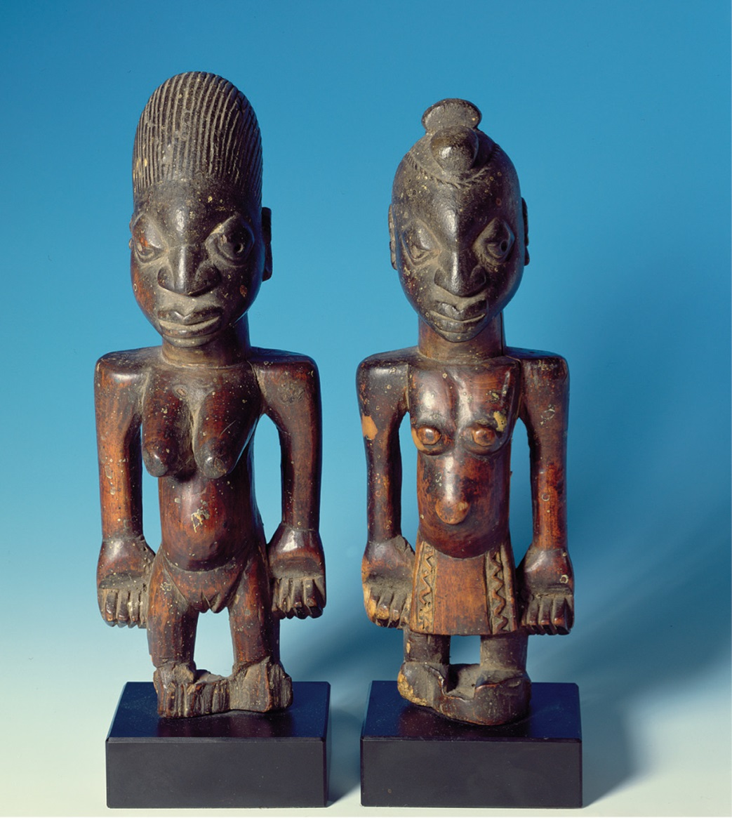
What Is Art? (5 of 5)
Notes:
Yorúbà wood carving follows esthetic principles that require clarity of line and form, a polished surface that creates a play of light and shadows, symmetry, and the depiction of human figures that are neither completely abstract nor completely realistic.

Slide 10
Studying Art in Society (1 of 4)
Influence of Franz Boas in first half of the twentieth century
  Learning by doing (apprenticeship)
  Topical focus on:
    The artist in cultural context
    The process of creating and using art
    Social functions of art

Slide 11
Studying Art in Society (2 of 4)
The anthropologist as apprentice
  Example: John Chernoff’s study of drumming in Ghana
    Had to learn about the culture and how drumming fits into it in order to become an expert drummer

Slide 12
Studying Art in Society (3 of 4)
Focus on the Artist
  Is art the product of tradition or individual agency?
    Example: Ruth Bunzel’s research in the U.S. southwest on Native American potters
  Social status of the artist and art
  Relationship to mode of livelihood
    More specialization and training expected in state-level societies
    Foraging and other small-scale societies offer equal access to art-making

Slide 13
Studying Art in Society (4 of 4)
Microcultures, Art, and Power
  Art may be used to legitimize power structures or gender roles
    Example: study of women in male strip clubs in Florida
  Art may be used as a vehicle of protest against inequality
    Example: hip-hop and verbal arts among urban Black youth in the United States

Slide 14
Performance Arts (1 of 4)
Ethnomusicology
  The cross-cultural study of music
  Well-established field of study linking cultural anthropology and musicology
  Studies music both from technical aspects (sound) and cultural context and meaning

Slide 15
Performance Arts (2 of 4)
Music and Gender among the Temiar of Malaysia
  Gender division of participation and roles in music reflects overall societal patterns of social and gender equality

Slide 16
Performance Arts (3 of 4)
Country Music and Globalization in Brazil
  Brazilian country music, música sertaneja, draws heavily on U.S. country music influences but features Brazilian themes
    Dupla singers demonstrate a focus on kinship and caring

Slide 17
Performance Arts (4 of 4)
Theater and Myth in South India
  Kathakali theater
    Blend of mythology, acting, and music
    Dramatizes great Hindu epics
    Makeup designates character types and moral qualities

Slide 18
Architecture and Decorative Arts (1 of 3)
May reflect class differences and social rank
Heterotopia: something formed from elements drawn from multiple and diverse contexts
  Example: European gardens in colonial times
    Included a diversity of species, perhaps to convey a sense of worldliness and sophistication

Slide 19
Architecture and Decorative Arts (2 of 3)
Architecture related to mode of livelihood and political organization
  Forager dwellings are the image of the family and not wider society
  Pastoralists have designed portable structures such as the teepee and the yert
  States show their power through the construction of monuments

Slide 20
Architecture and Decorative Arts (3 of 3)
Gardens and Flowers
  Decorative gardens are a product of state-level societies
  Japanese gardens may contain no flowers
  Traditional Muslim gardens are enclosed by four walls
  Cross-cultural variation of importance of flowers in art: flowers are not a prominent motif in African art, perhaps related to the environment

Slide 21
Museums and Culture (1 of 3)
A museum collects, preserves, interprets, and displays objects on a regular basis
At least two functions:
  Esthetic
  Educational

Slide 22
Museums and Culture (2 of 3)
Critique of ethnographic museum collections and displays
  Who gets to represent whom
  Who owns particular objects; repatriation
  Need to provide ethnographic context

Slide 23
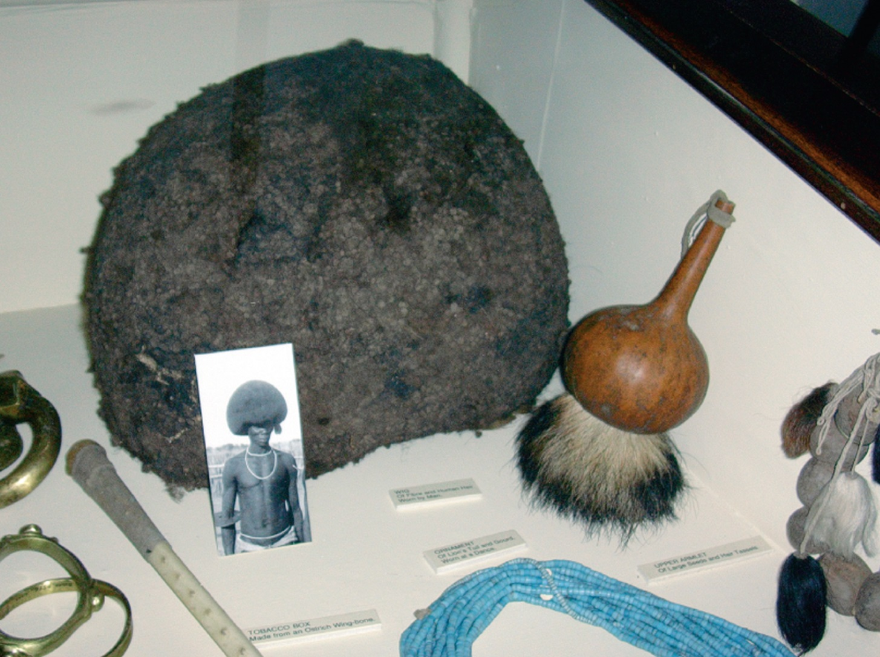
Museums and Culture (3 of 3)
Notes:
A display of African artifacts collected by British colonial-era explorers and early anthropologists, shown with minimal labels, at the Powell-Cotton Museum in Kent, southeast England. This museum is moving toward exhibits that provide more context while preserving some of its “colonialist” exhibits as examples of their time.

Slide 24
Play, Leisure, and Culture (1 of 3)
13.2 Illustrate what play and leisure reveal about culture.
Games and Sports as a Cultural Microcosm
Leisure Travel

Slide 25
Play, Leisure, and Culture (2 of 3)
What is “play”?
  Unnecessary activity (though may be functional in some ways)
  Limited in terms of time (it has a beginning and ending)
  Rules for how to play
  May involve chance and tension
  May or may not be competitive

Slide 26
Play, Leisure, and Culture (3 of 3)
What is “leisure”?
  Overlaps with play, but does not necessarily include rules, chance, or tension
    Examples: lying on a beach, vacation travel
Anthropologists study play and leisure within their cultural contexts as part of social systems
  Social roles and social status of participants?
  Related to group identity?
  How has it changed over time?

Slide 27
Games and Sports as a Cultural Microcosm (1 of 3)
Clifford Geertz suggests sports can be models of and models for a culture
  Example: baseball players from the United States and Japan
    U.S. players tend to have an individualistic attitude
    Japanese players, in accordance with the Japanese concept of wa, are more team-oriented

Slide 28
Games and Sports as a Cultural Microcosm (2 of 3)
Sports and Spirituality: Male Wrestling in India
  Study of Hindu male wrestlers
    Physical and mental discipline
    Dietary rules
    Similarities with Hindu ascetics

Slide 29
Games and Sports as a Cultural Microcosm (3 of 3)
Play, Pleasure, and Pain
  Blood sports
    Competition that explicitly seeks to bring about the flow of blood (animal, human)
  Why? Various explanations:
    Sadistic tendencies of spectators/participants
    Self-validation, especially of males
    Symbolic of triumph of culture over nature

Slide 30
Leisure Travel
Often marketed as providing an “authentic” view of “primitive” cultures
Tourists often seek to find the culture the tourist industry defines rather than the real one
Anthropologists are concerned with the impact of tourism on indigenous peoples
Some local communities have taken an active role to secure proceeds and maintain the location
  Example: Guanacaste National Park, Costa Rica

Slide 31
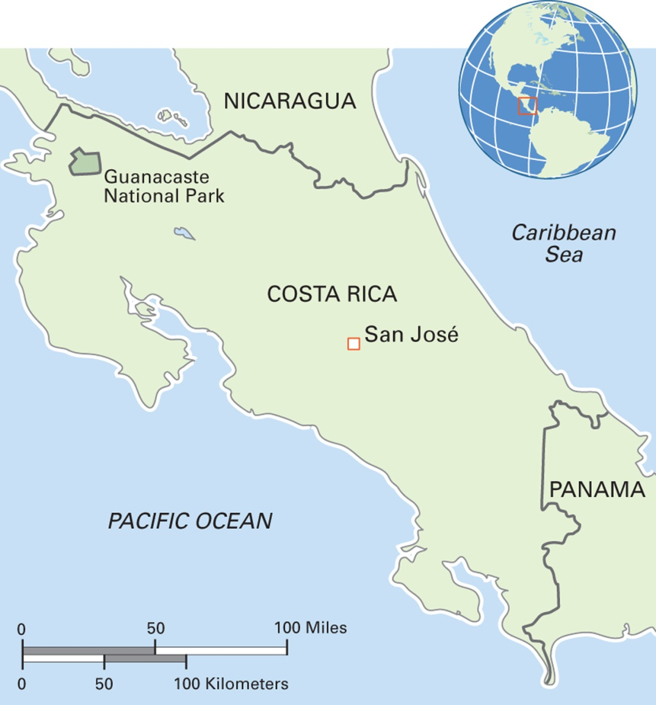
Map 13.2 Costa Rica
Notes:
The Republic of Costa Rica was the first country in the world to constitutionally abolish its army, and it has largely escaped the violence that its neighbors have endured. Agriculture is the basis of the economy, with tourism—especially ecotourism—playing an increasing role. Most of the 4.6 million inhabitants of Costa Rica are descended from Spanish colonialists. Less than three percent are Afro-Costa Ricans, and less than two percent, or around 50,000, are indigenous people. Seventy-five percent of the people are Roman Catholic and 14 percent Protestant. The official language is Spanish.

Slide 32
Culturama: The Gullah of South Carolina (1 of 2)
The Gullah are descended from African slaves originating in West and Central Africa
The slaves brought with them knowledge about how to grow and harvest rice in swamps
Developed tidal irrigation methods of rice growing
Handwoven nets are masterpieces of folk art
Textile arts include quilts that tell a story in their several panels

Slide 33
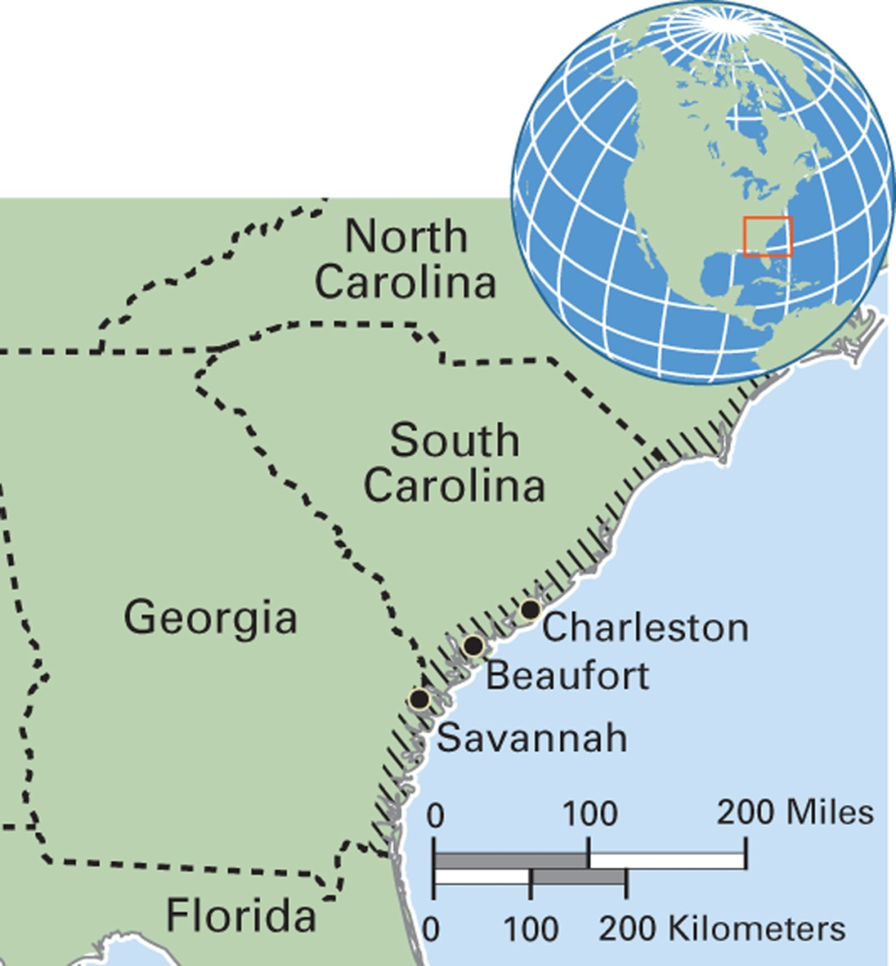
Map 13.3 The Gullah Region
Notes:
The heartland of Gullah culture is in the lowcountry areas of South Carolina, Georgia, and Florida, and on the Sea Islands.

Slide 34
Culturama: The Gullah of South Carolina (2 of 2)
Cuisine combines African and Indian elements
Has become a major tourist attraction
Particularly identified with sweetgrass baskets (woven by men and women)
  Demand for sweetgrass has created a conflict between Gullah cultural producers and land developers
  Development is destroying the land on which sweetgrass grows
  Planners are trying to find ways to devote land to growing sweetgrass

Slide 35
Change in Expressive Culture
13.3 Explain how cultural heritage is a contested resource in contemporary times.
Colonialism and Syncretism
Tourism’s Complex Effects
Cultural Heritage as a Contested Resource

Slide 36
Colonialism and Syncretism
Example: cricket in the Trobriand Islands
  British colonialists launched cricket playing in the islands as a replacement for warfare
  Over time, the Trobrianders have remade British-style cricket into a syncretized form that fits with their culture, including status competition and intergroup feasting

Slide 37
Tourism’s Complex Effects (1 of 2)
Tourism, especially international tourism, has brought a demand for “traditional” forms of expressive culture
  Example: Vietnamese water puppetry
Raises questions of “authenticity” when traditional forms are changed to please tourists’ desires and schedules

Slide 38
Tourism’s Complex Effects (2 of 2)
Positive result of global tourism is recognition of:
  Material cultural heritage
    The sites, monuments, buildings, and movable objects considered to have outstanding value to humanity
  Intangible cultural heritage
    UNESCO’s view of culture as manifested in oral traditions, languages, performing arts, rituals and festive events, knowledge and practices about nature and the universe, and craftmaking

Slide 39
Anthropology Works: A Strategy on Cultural Heritage for the World Bank
Michael Cernea, cultural anthropologist, worked for the World Bank for over 30 years
One area of work was to engage the World Bank in linking economic development via tourism to cultural heritage preservation
He developed a strategy for the World Bank for the Middle East and North Africa

Slide 40
Cultural Heritage as a
Contested Resource
Issues related to cultural heritage use and preservation
  Who defines cultural heritage in terms of what is authentic or inauthentic
  How to design and carry out cultural heritage preservation to address both insider and outsider roles and interests
  The grim reality of how power, either local or global, can overwhelm local efforts to define and manage cultural heritage for the benefit of local people, especially the poor

Slide 41
Art for Good
Emily Joy Rothchild’s work in Hamburg, Germany
  Research on a school intended to integrate children of immigrants into German society
  Children take classes in rap, dance, “beat-box,” and graffiti art
  Provides the Muslim students a way to express views against discrimination and terrorism

